Slide 1

Contents
Introduction
Scope
Timeline
Findings
Artefacts
Conclusion

Slide 2

Introduction
Overview of forensic examination scope and purpose
Key investigation focus area, User activity, including OS, partition details, email forensic, web searches, recycle bin, unallocated space analysis, registry evaluation, and RAM artifacts
Importance of Timestamps and maintaining a Chain of Custody

Slide 3

Scope
Evidence Acquisition for Steve Kowhai’s Computer
Images were acquired from Steve’s drive and memory using a software write blocker to prevent modification
Chain of Custody Maintenance
Ensure the chain of custody was preserved in the required format
To uphold evidence reliability during audits
Data integrity Verification
Digital hash values verified at the scene confirmed evidence remained intact and unaltered throughout the analysis

Slide 4
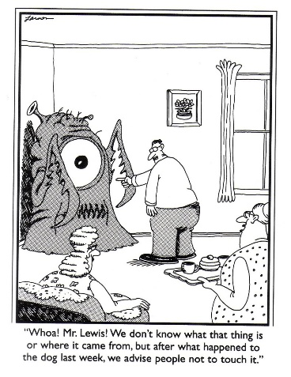

Slide 5
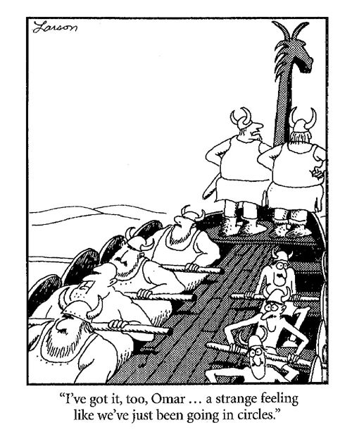
Timeline and Findings
Timeline Analysis - Investigated User Recent activity revealing significant timestamps and user action. Opened documents and travel plans (e.g. flight details) indicated coordination with John in Brisbane
Registry View and OS Analysis - Identified user login credential (Steve Kowhai) and computer name (SK-Desktop). Recent file timestamp linked to smuggling operation evidence.
Communication Log Examination – Uncovered communication involving Discord and Prontonmail. Found emails, chat logs, and files pointing to drug trafficking activities.
Web searches and downloads
Unallocated and Recovered Files - Recovered deleted files from the Recycle
Drug paraphernalia | 2019-01-31 15:57:30 NZDT
Crystal meth | 2019-01-31 15:56:24 NZDT
Gangs NZ drugs | 2019-01-31 15:59:32 NZDT
Best places to trade drugs | 2019-02-02 14:01:34 NZDT
Cutting drugs | 2019-01-28 22:58:52 NZDT
Cutting agents for ice | 2019-01-28 23:02:00 NZDT
How to launder money | 2019 -01- 28 23:03:51NZDT
Drug routes in Wellington | 2019-01-29 01:01:58 NZDT
International drugs routes | 2019-01-29 01:04:16 NZDT

Slide 6
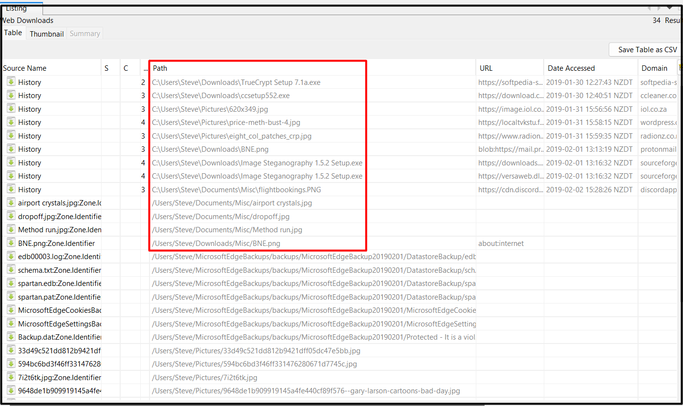
Findings
Desktop computer SK-Desktop has a user Steve Kowhai who was searching for the Scope of selling drugs (refer S012) and Global meth flow and countries shared in the world (refer S010 and S011)
User Crayfish1980 on domain protonmail belongs to user Steve (refer to S045 and S046)
An encrypted email conversation between Crayfish1980 and heresjohnny1 (refer S050) suggests that they were in talk about methamphetamine.
User Steve obtained an encrypted file BNE.png image from John's protonmail, which contained meth packets in a suitcase
He also shared Flight bookings from Brisbane to Wellington and back (refer to S026 for site and S027 for confirmed booking)
They were due to meet at Eastbourne Library and an alternate place, 666 Rewera Avenue, if they missed each other. (as shown below in the transcript)

Slide 7
Discord Chat Interception
John | Timestamp | Steve | Timestamp
"New supplier, eh? Definitely Interested! Can I get 10 keys of it delivered to Wellington" | 2019-01-28 02.38.38.174 NZDT | “Yeah, yeah probably wiser, good one. In fact, I have already put a document together in anticipation of chatting with you. I'll send it through now. It contains some information regarding how I see this working out. Let me know what you think once you have read it S.O"} | 2019-01-30 12:04:09 NZDT
“Good Thinking, I already know how. Heard of steganography?" | 2019-01-30 02:56:12.835 NDZT | "A way of hiding one image within another. There's a simple application called 'Image Steganography'." | 2019-01-30 02:56:12.35NZDT
“Ya. I just told you about the tool: face_palm: Received it. Will check to see if it works and confirm soon. " | 2019-02-01 13:11:39 NZDT | "Good. Meet at the Eastbourne library and if we miss each other come to 666 Rewera Avenue, Petone." | 2019-01-31 02:10:36.655NZDT

Slide 8
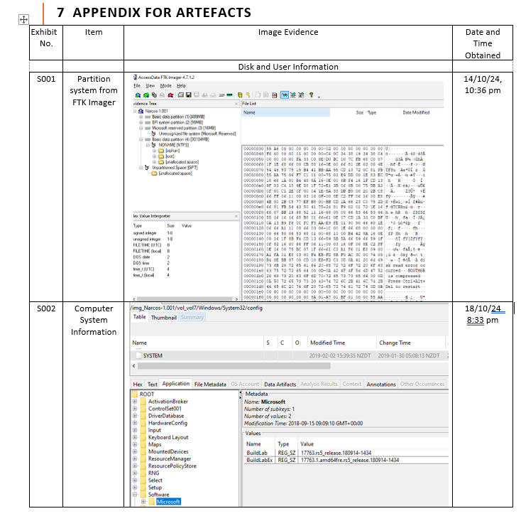

Slide 18
